Slide 1
Automated monitoring system based on Kinect camera
Peter Skudarnov, Maxim Emelin
Project
Supervisor: Dr.-Ing. Anake Pomprapa

Slide 2
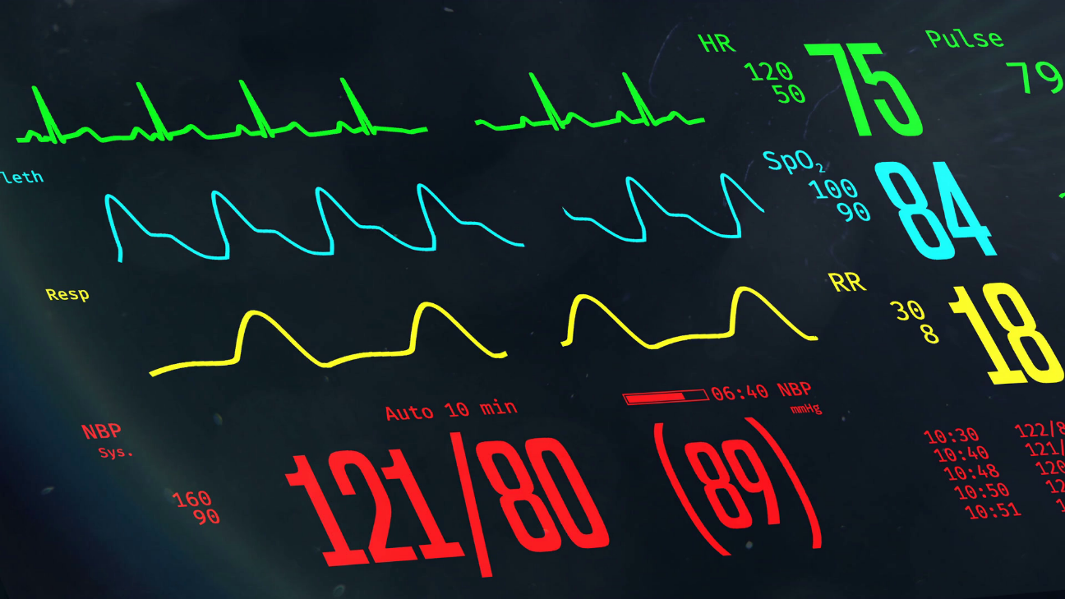
Motivation
Economical way to monitor patients
Real-time interpretation
Adoptable solution

Slide 3
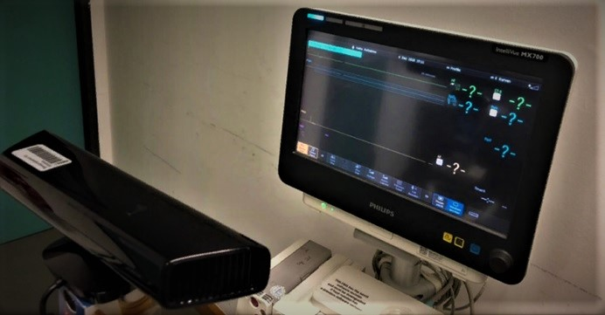
Assigned Tasks
Determine conditions for real-time monitoring
Develop algorithms for the detection of parameters

Slide 4
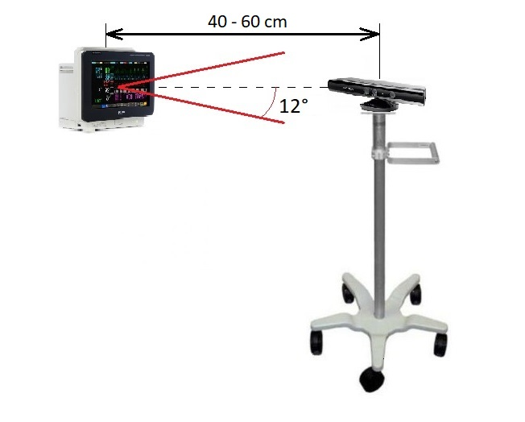
Course of Action
Solutions using MATLAB:
Detection of the screen
Locating and recognition of numbers
Reacting on the disturbances
System configurations:
Distance – 40-60 cm
Max angle - 12°
Max sampling speed – 2.7 Hz

Slide 5

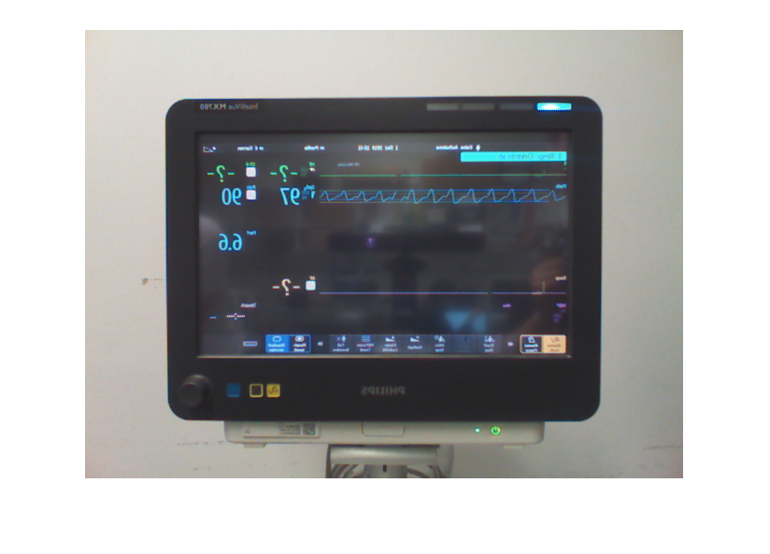
Screen Detection
Using infra-red camera
Using ordinary camera

Slide 6
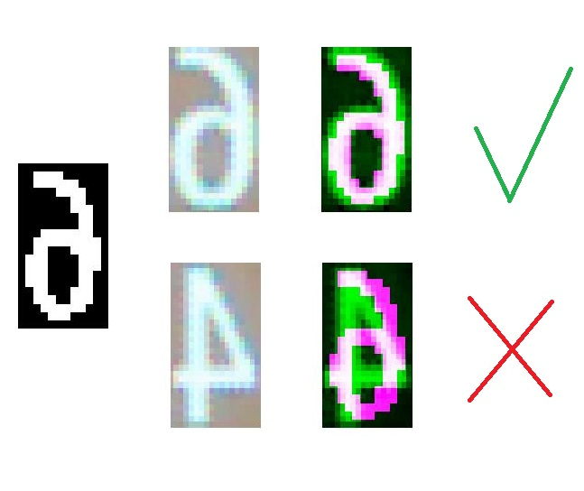
Numbers Detection
Recognition of numbers
Database of etalon numbers
Acquisition of number
Comparison of numbers

Slide 7
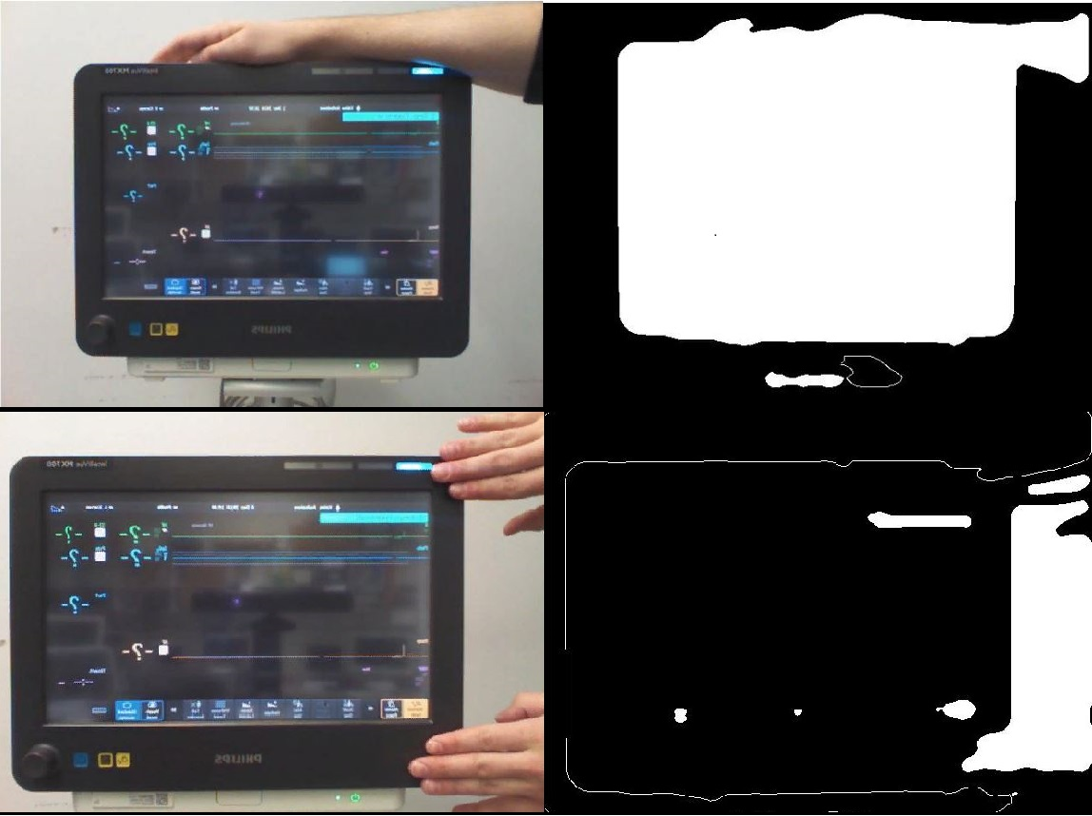
Disturbances
Disturbances
Screen detection error
Elimination of detecting error
Resulting output

Slide 8
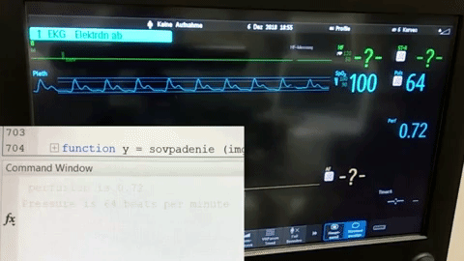
Results
Real-time detection of parameters

Slide 9
Future Works
Extending the area of detecting parameters
Developing the algorithms using neural networks
Increasing recommended parameters for the camera-based detection

